Slide 1


Hate Speech Detection on Reddit
Or
How to Wrangle Big Data While Being Careful With Resources
Thomas Lever
Hannah Koizumi
Anonymous

Slide 2















Motivation
Ever increasing online content
Increased hate speech
Connect data science with social media policy changes
Brand Guidelines linked to logos
YouTube not shown – required permission for any use

Slide 3

Why?
Reddit’s major content policy change on June 29, 2020
Rule 1 Ban communities and users that promote hate based on identity or vulnerability
Rule 2 Abide by community rules and post with authentic, personal interest
Initially banned over 2,000 communities
r/The Donald (right)
r/Chapo Trap House (left)
Torrent availability for all Reddit submissions
Source: https://techcrunch.com/2020/06/29/trump-suspended-from-twitch-as-reddit-bans-the-the_donald-and-additional-subreddits/

Slide 4
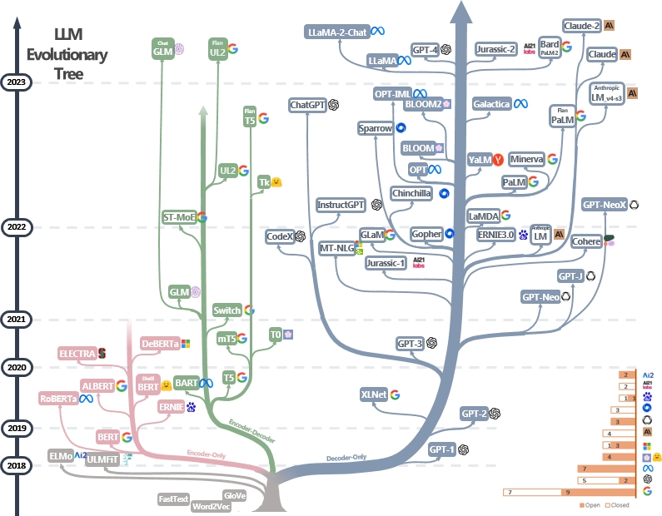

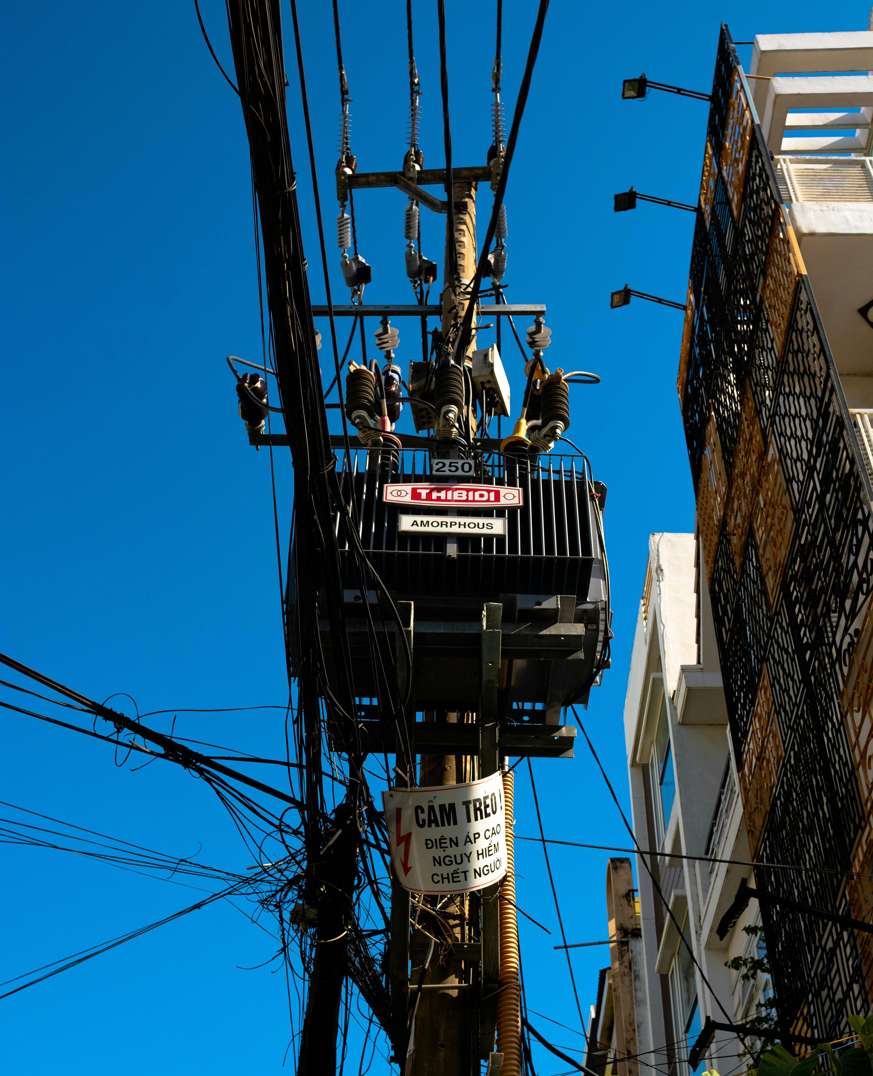
How?
Transformers
Source: https://github.com/Mooler0410/LLMsPracticalGuide/blob/main/imgs/tree.jpg

Slide 5



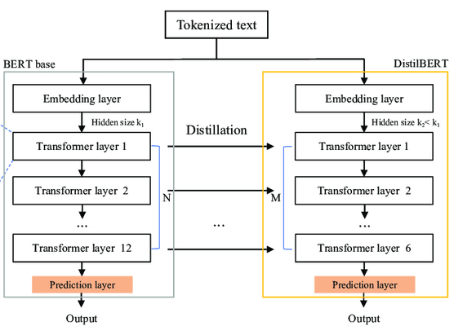
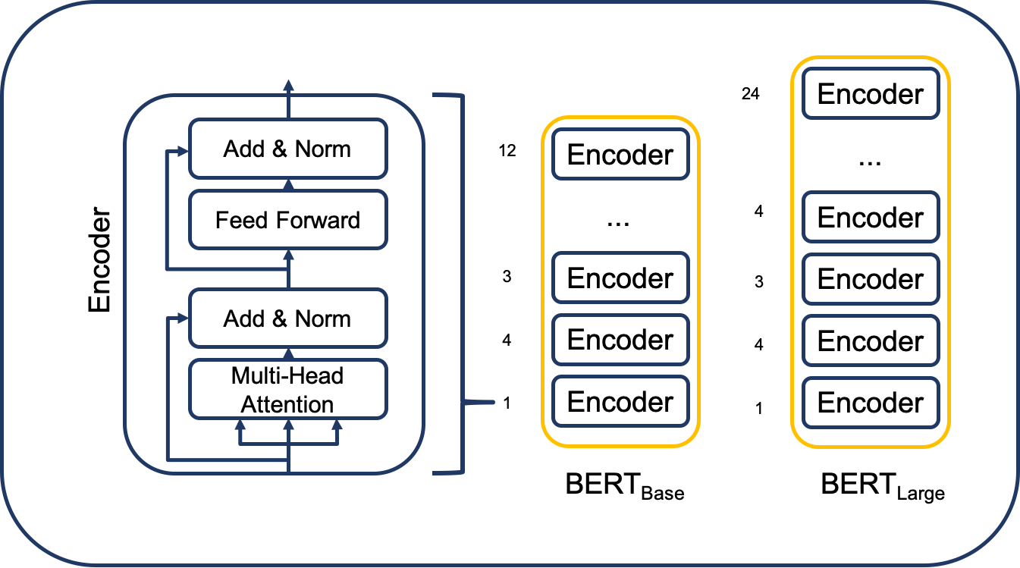
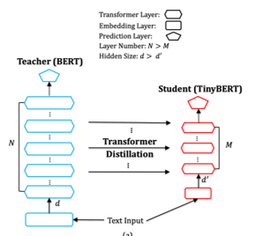



Models
BERT
DistilBERT
TinyBERT
Huawei Noah’s Ark
& Huazhong U. of S&T (2019)
Training Data & Best Validation Performance:
Hatespeech – Imbalanced
F1: 67.3% Acc: 89.2% Prec: 73.5% Recall: 62.0%
Hatespeech – Balanced
F1: 87.0% Acc: 86.4% Prec: 83.9% Recall: 90.3%
Google (2017)
Training Data:
Hatespeech – Imbalanced
Best Validation Performance:
F1: 73.1% Acc: 90.2% Prec: 71.6% Recall: 74.6%
Hugging Face (2019)
Training Data: Ethos
Best Validation Performance:
F1: 79.5% Acc: 85% Prec: 79.5% Recall: 79.5%
Sources linked to images
Notes:
Two steps for BERT – pre-training and fine tuning

Slide 6

Model Flow
Fine-Tuning
Pre-trained
Masked
Book Corpus
Wikipedia
12 layers
Pre-trained
Distillation from BERT’s responses
6 layers
Pre-trained
Distillation
Task specific training
2 layers
Supervised Learning
Hate Speech Imbalanced
Hate Speech Balanced
Ethos
Hate Speech
Input
Reddit Data
BERT
Or
Or
Classifier
DistilBERT
TinyBERT
Not
Hate Speech
Graphic: Author rendered
Source idea: https://jalammar.github.io/illustrated-bert/

Slide 7
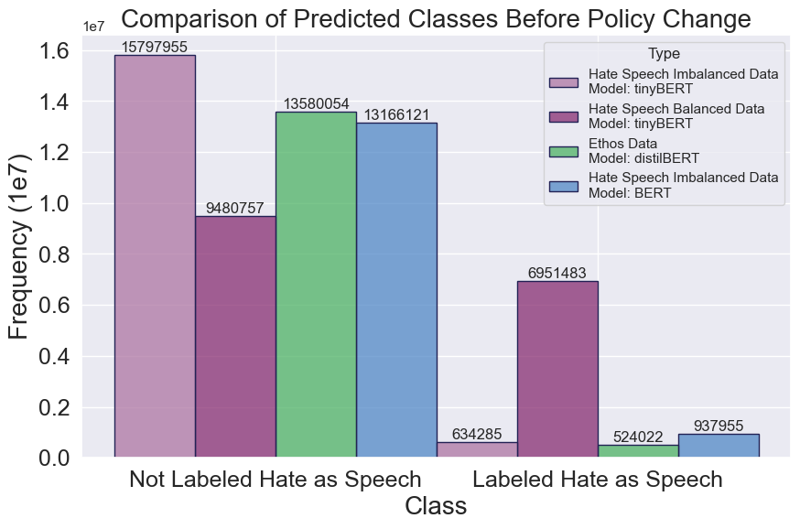
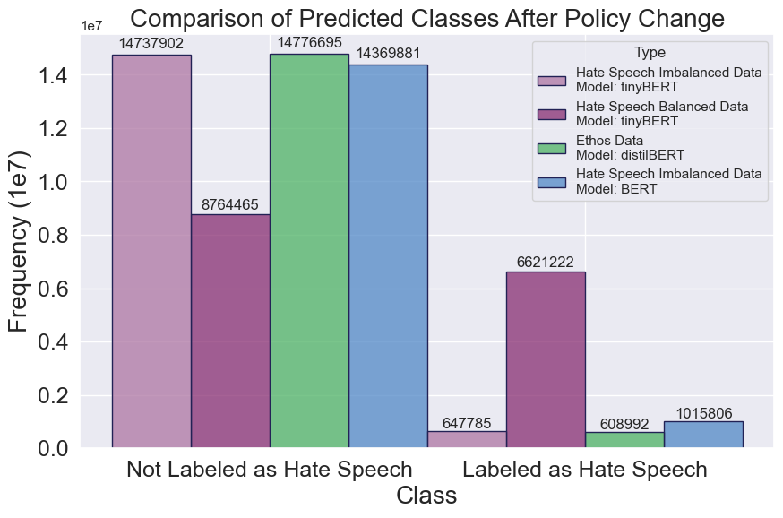
Results (Predicted Hate Speech)
Notes:
About 2 percent (21 / 1000) texts in our testing data set were hate speech.

Slide 8
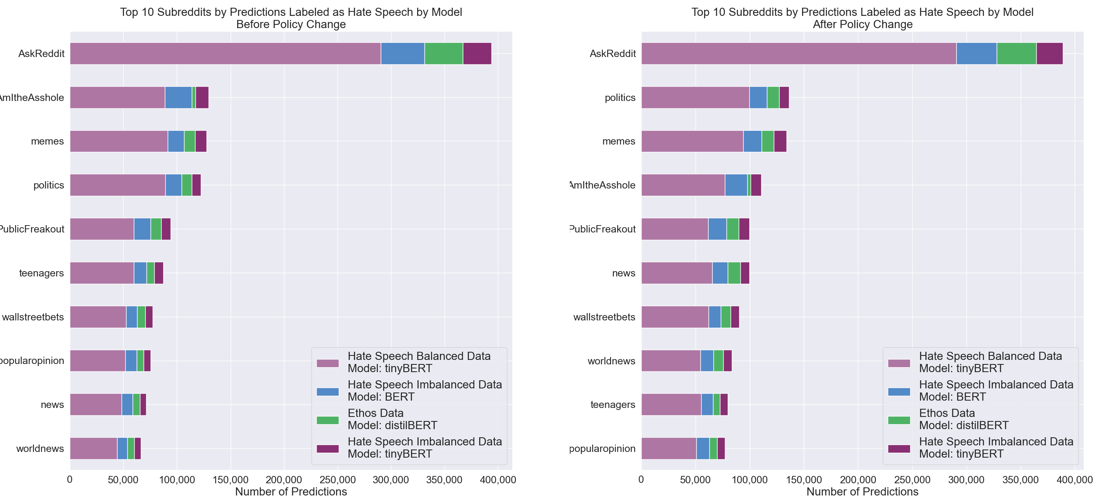
Results (Top 10 Subreddits)

Slide 9
Results (Qualitative)
Methodology
Random sample of 482 Before and 491 After predictions
Reviewed without knowledge of model predictions
Combined model and team review results
Insights
Limitations of comment only predictions
Most models identified clear cut hate speech
Trends:
High False Positives
TinyBERT Balanced
High False Negatives
DistilBERT Ethos
Higher Sensitivity to Curse Words
TinyBERT Imbalanced
BERT Imbalanced
Least Sensitive to Curse Words/Hate Speech
DistilBERT Ethos
Notes:
Identifying hate speech without context of the submission or other comments is limiting
For clear cut examples of hate speech, there was a consensus among the models where most or all of them identified them as such
We were able to observe some trends among models:
TinyBERT trained on balanced data was the only model that objectively failed at identifying hate speech with a large amount of false positives.
TinyBERT imbalanced and BERT were more sensitive to curse words than distilBERT, which was the least likely to mark something as hate speech and most prone to false negatives

Slide 10
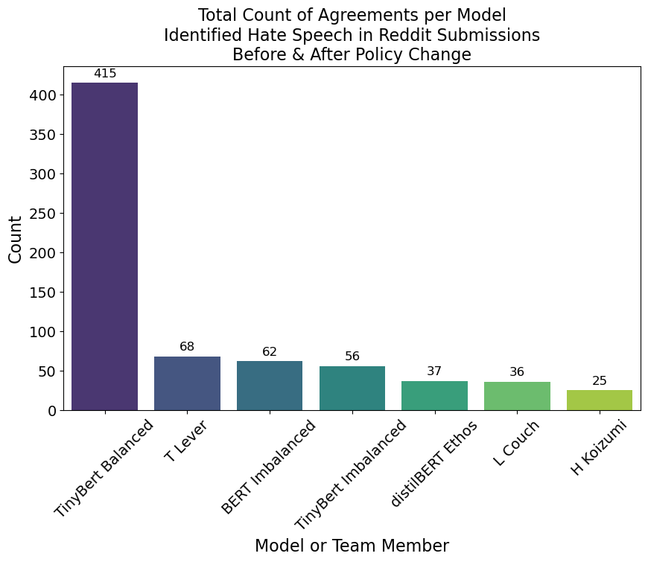
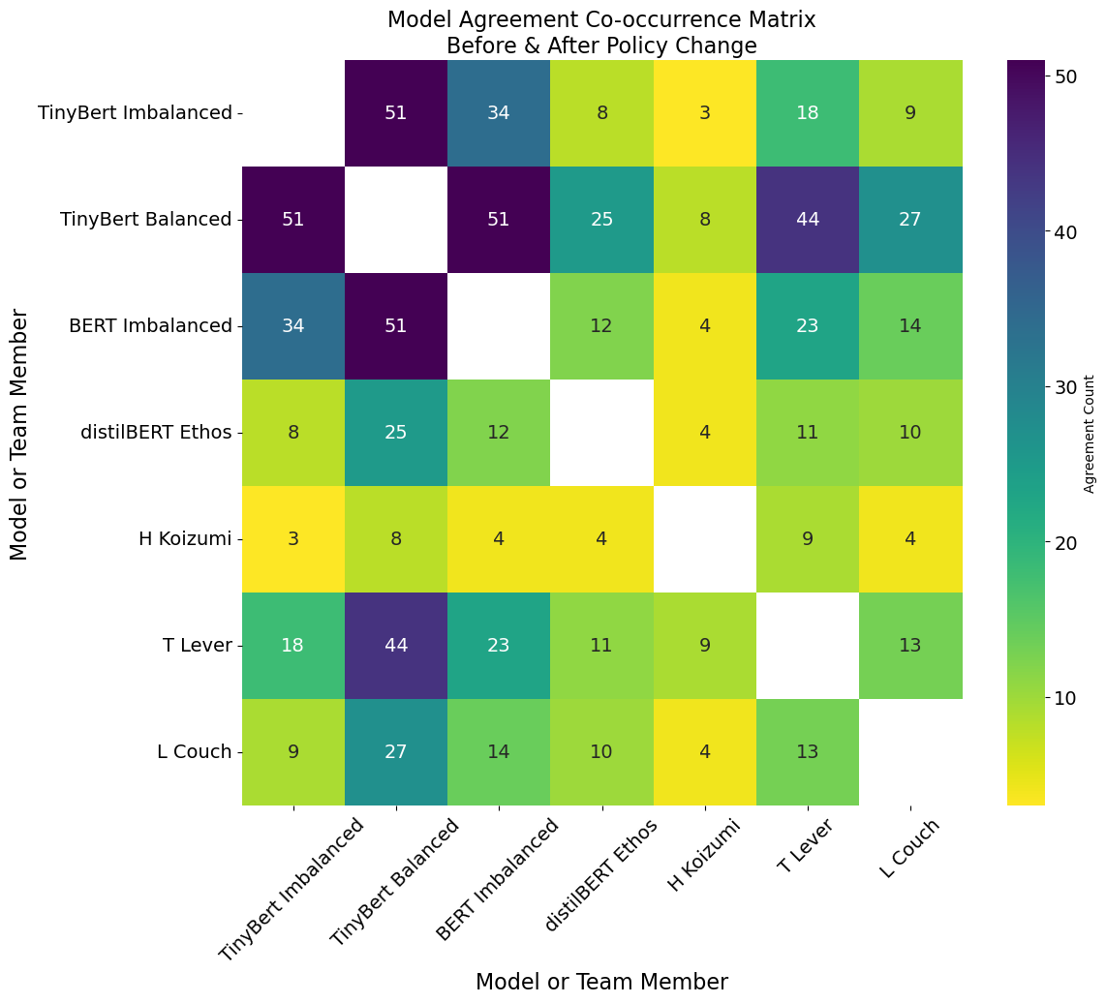
Results (Qualitative)
Before and after as one plot so total
Notes:
Identifying hate speech without context of the submission or other comments is limiting
For clear cut examples of hate speech, there was a consensus among the models where most or all of them identified them as such
We were able to observe some trends among models:
TinyBERT trained on balanced data was the only model that objectively failed at identifying hate speech with a large amount of false positives.
TinyBERT imbalanced and BERT were more sensitive to curse words than distilBERT, which was the least likely to mark something as hate speech and most prone to false negatives

Slide 11
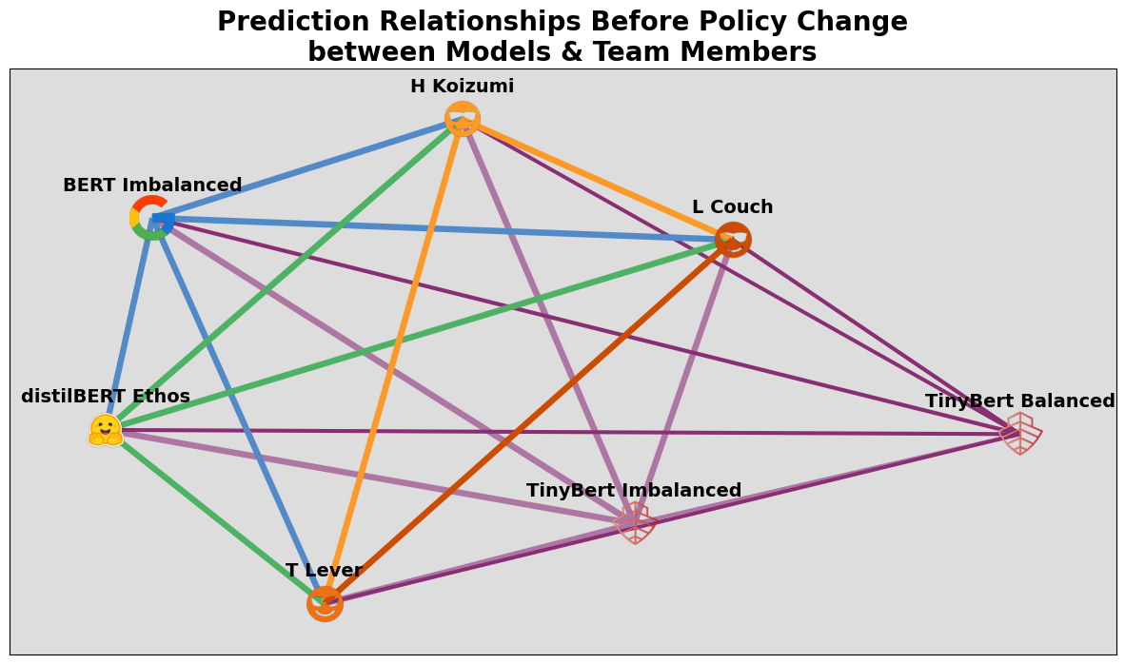
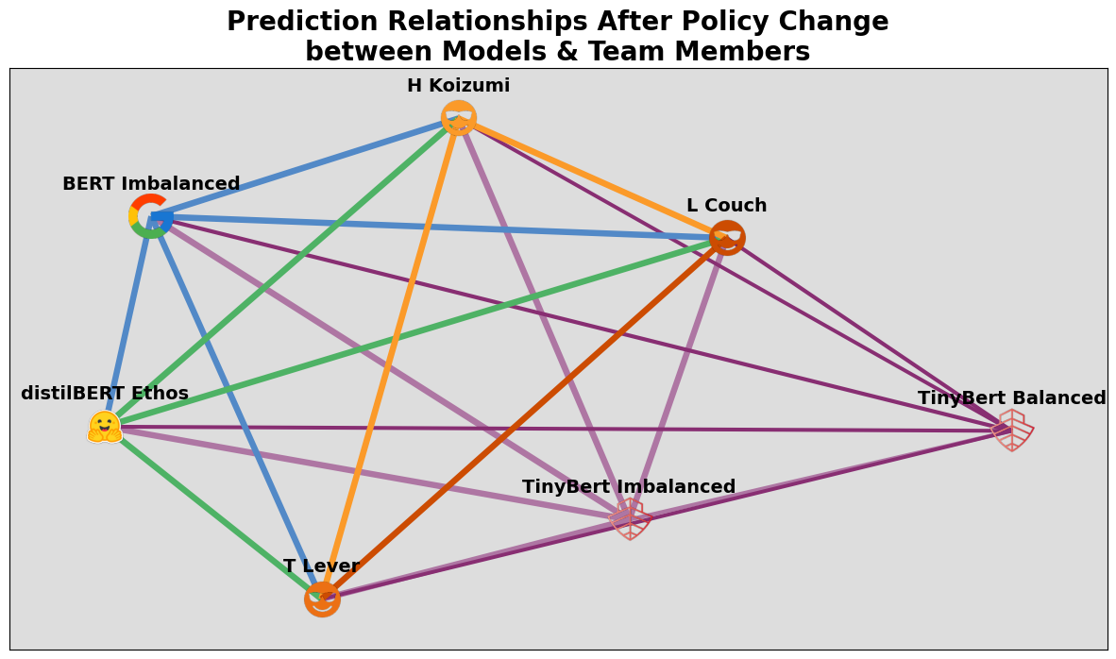
Results (Qualitative)
Notes:
Identifying hate speech without context of the submission or other comments is limiting
For clear cut examples of hate speech, there was a consensus among the models where most or all of them identified them as such
We were able to observe some trends among models:
TinyBERT trained on balanced data was the only model that objectively failed at identifying hate speech with a large amount of false positives.
TinyBERT imbalanced and BERT were more sensitive to curse words than distilBERT, which was the least likely to mark something as hate speech and most prone to false negatives

Slide 12
Conclusion
Be careful with resources
Homogenize data sets and performance metrics
Improve performance
No clear impact of policy change on hate speech
Hate speech can be difficult to identify
Models were able to identify clear cut hate speech
A paper and code may be shared with the public to encourage further research

